Slide 1
Borrowing money from a friend can harm or damage the friendship.
TOPIC
Group: 6
Members: Senrin Sim
Khav Saroeun
Samorn Mai
Notes:
Hello, theacher and hello everyone . I’m from group 6, my team member are (senrin sim, mai samorn, and khav saruen) This morning we going to show you all about one TOPIC that talk about BORROWING MONEY FROM YOUR CAN HARM OR DAMAGE THE FRIENDSHIP. Hrr ohh what is the meaning of this topic? So to make it clea and make sour for you all get understand the topic les’go to the presentation all together. Les’go!

Slide 2
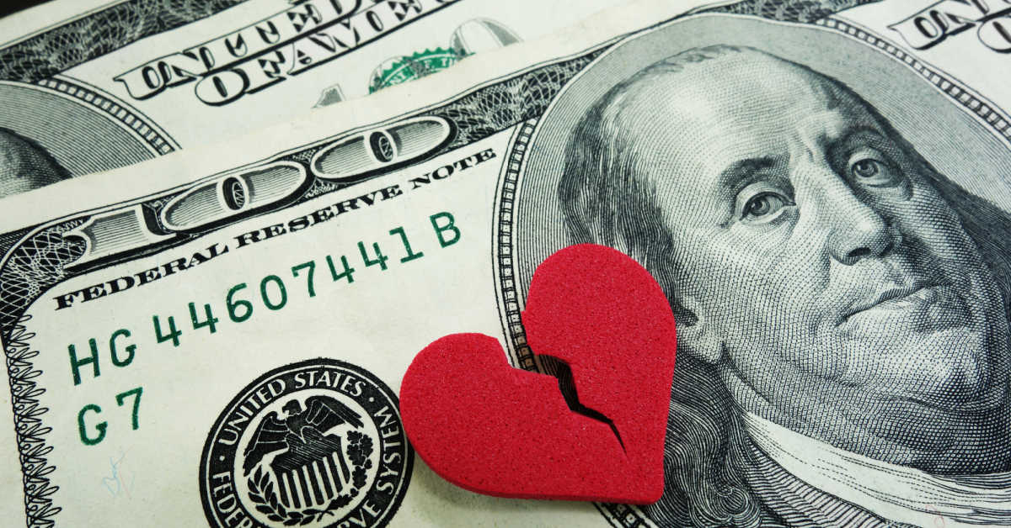
Relationship is broken only a reason is BORROW money.
Notes:
Nowaday, in our modern world, some kind of relationship was broken only a reason for borrowing money.
It is my personal opinion if you borrowing money from your friend and never return it back,
so in that cas it harm your friendship.
But if you return it on the time it can not harm your friendship.

Slide 3

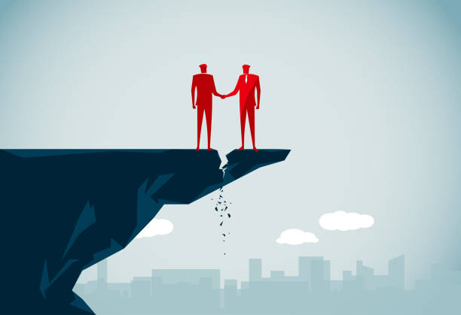
It was harm of your friendship if you don't pay the money back to your freind.
We are best freind
We are not freind
Notes:
It was harm of your friendship if you don’t pay the money back to your friend. Now we are friendship after when you borrow money from your friend make you and your friend not friendship​ and enemy each other between you and your friend forever. Because your friend can be gossip you and not longer trust about you.

Slide 4
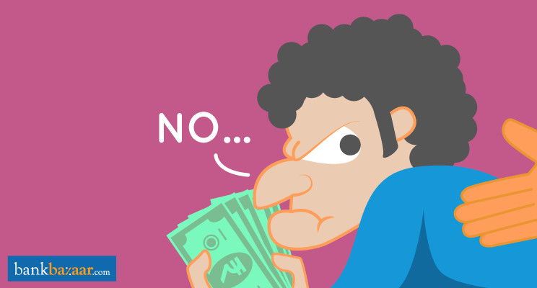
If you borrow money from your friend and you never return back to your friend.
You will make a relationship to be broken.
Your friend don’t trust on you.
Notes:
If you borrow money from your friend and you never return back to your friend it mean you are a bad person already in your friend mind. Because what?
He will think about you that you are a untrust person in his mind, Because you have had cheating your friend by you not pay money back to your friend. And you proboly made your friendship to be broken also. In the this point I mean you will make a relationship to be beoken and make your friend don’t trust on you when you want your friend’s help in the next time. Why I say like that? Go to the next slide I going to show you about a reason that you make your relationship was broken cause only borrowing money.

Slide 5
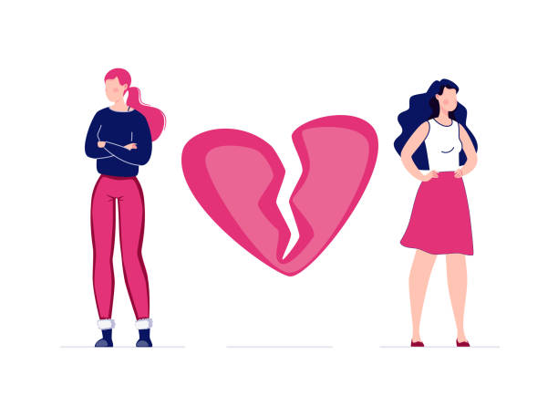
Relationship is broken.
When you never pay back the money to your friend.
Notes:
In this dark side, if you borrowing money from a person and never return, it would harm your friendship. For example, someday ago my friend borrowed money from me. I was not sure about him, but he requested to me to he needs money for some inportant reason. So I believed and gave money. After that when I call hem, he never picked up my phone or never replied to my messages. In that case he aboided me and never contacted me to return my money. So tin that time it had harming our friendship. And make me don’t trust him also. Why I don’t trust ? Go to the next slide my friend will show you.

Slide 6

I gave him some money that he want.
Notes:
In this dark side, if you borrowing money from a person and never return, it would harm your friendship. For example, someday ago my friend borrowed money from me. I was not sure about him, but he requested to me to he needs money for some inportant reason. So I believed and gave money. After that when I call hem, he never picked up my phone or never replied to my messages. In that case he aboided me and never contacted me to return my money. So tin that time it had harming our friendship. And make me don’t trust him also. Why I don’t trust ? Go to the next slide my friend will show you.

Slide 7
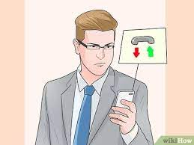
He desn’t pay back my money.

Slide 8
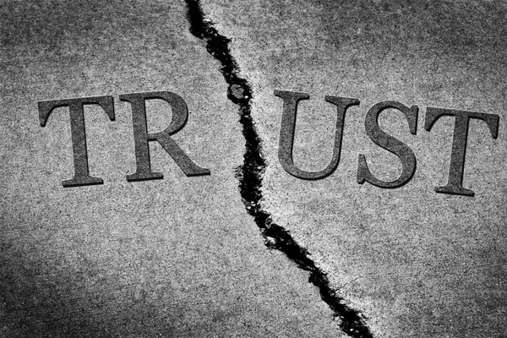
Your friend don’t trust on you.
Notes:
. Well, Like my friend told you some points above.We can say that borrowing money from friends and you don’t pay back it can harm or damage the friendship.​And make you don’t trust your friend. Example some days you see your friend have money but he or she always doesn’t pay back it make your feel don’t happy.And maybe you thinking alone that “why he doesn’t pay back while he have money.And a lot of questions stay in your brain.
In addition , If you don’t pay back .Your friend will gossip about you to other friends. And make you lose confidence when you meet other friends or lose the trust of your friends at all. So it makes you feel lonely.

Slide 9
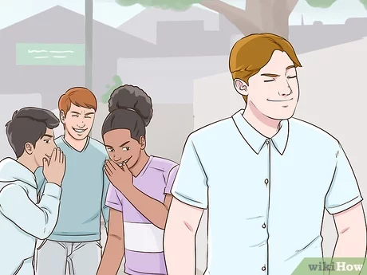
Your friend gossip on you.
Notes:
In addition , Yes, it is possible that your friend might gossip about you if you don't turn back money to them. and they might want to warn others about you.
If your friend does gossip about you, it can be hurtful and damaging to your reputation. It can also make it difficult to maintain other friendships, as people might be hesitant to trust you if they've heard negative things about you.

Slide 10

CONCLUSION
To sum up, when you borrow the money and you always returning at that time, it will help to keep your friendship stronger and never cut the relationship.
Notes:
To sum up, I think that borrowing money and returning at on time,it will help to keep your friendship stronger and never cut the lelationship.

Slide 11
THANK YOU!

